Slide 1
Object Oriented Analysis and Design
State Diagram /State Machine

Slide 2
State Diagram /State Machine
A state Transition diagram, also known as a state machine diagram, is a type of behavioral diagram in the Unified Modeling Language (UML) that shows different states of a component / object in a system which may controlled by external or internal events

Slide 3
State Diagram /State Machine
Model the dynamic nature of a system.
Describes different states of a component / object in a system which may controlled by external or internal events.
Main purpose is to model the reactive system

Slide 4
How to Draw a State Diagram
Identify the important objects to be analyzed.
Identify the states.
Identify the events.

Slide 5
Applications
Model the states of an object during its life time
To model events
To model the reactive systems
Forward and reverse engineering

Slide 6
Components of a State Diagram
State
Nesting
Decision Point
Notes
Start State
Stop State
Transition
&
Self-Transition
Guard Condition/
Action
[ CorrectDetails ]
/ acceptPolicy

Slide 7

State
Indicates the status, condition or current nature of an object.

Slide 8

State Transition
An action which represent a change from one originating state to successor state

Slide 9


Special states
First state – Start
Final State - Stop

Slide 10
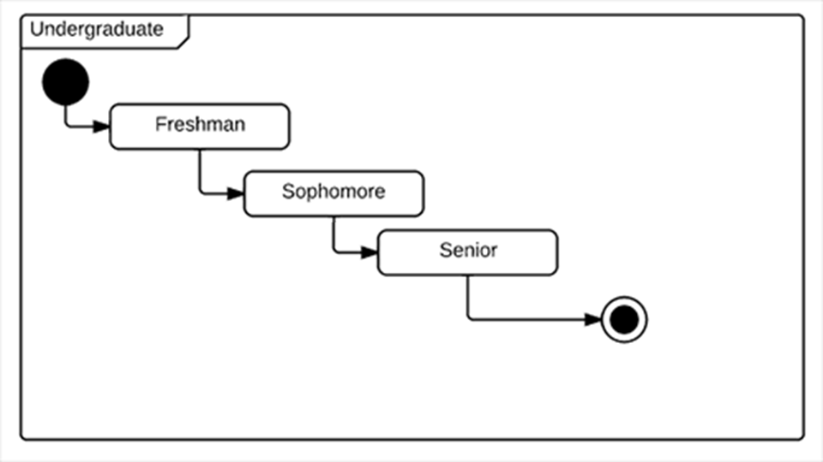
The Undergraduate

Slide 11
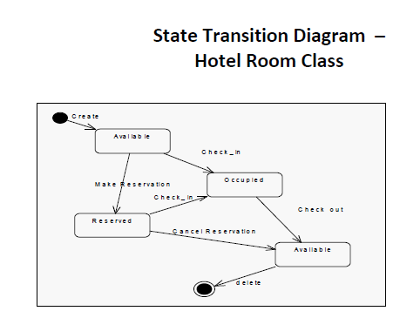

Slide 12
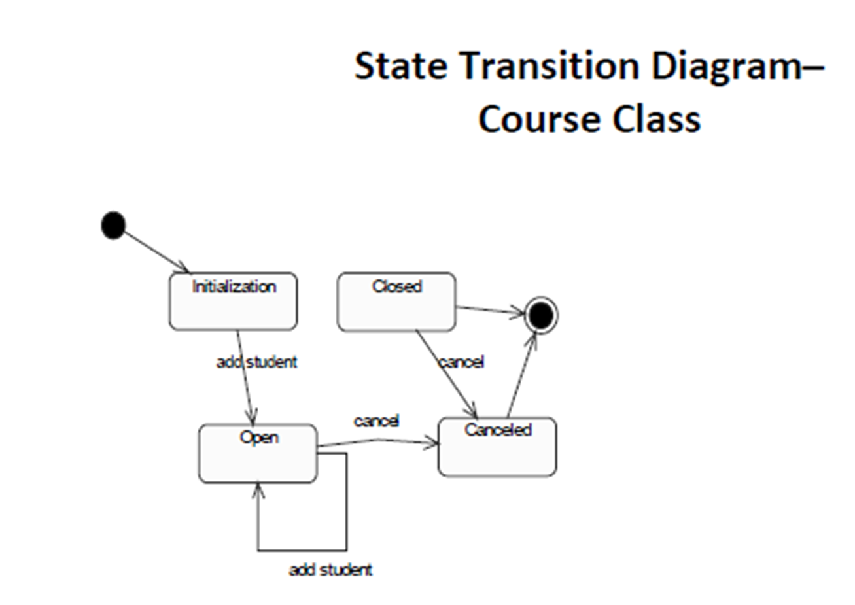

Slide 13
State Details
Entry Action
Behavior that occurs while the object is transitioning to the state
Shown inside the state proceeded by entry and colon

Slide 14
State Details
Activity
Behavior which an activity carries out while it is in a particular state
Depicts inside the state preceded by the word Do and a semi colon

Slide 15
State Details
Exit Action
Behavior that occurs while the object is transitioning out from the state
Shown inside the state proceeded by Exit and colon

Slide 16
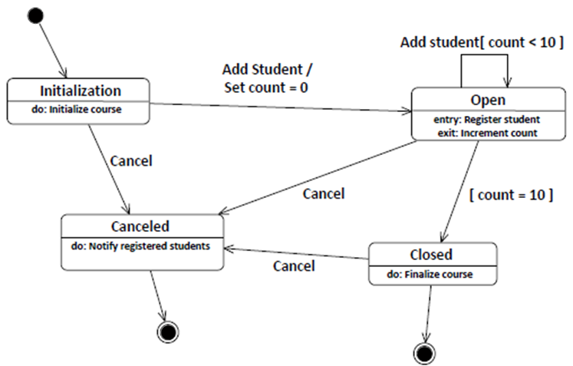
Course Offering

